Slide 1
CST 205 OOP :Object modeling using UML

Slide 2
OBJECTIVES
To give an introduction to UML
To explain about UML diagrams
To discuss about use case modeling

Slide 3
UNIFIED MODELLING LANGUAGE
UML is a language for documenting models.
UML has its syntax (a set of basic symbols and sentence formation rules) and semantics (meanings of basic symbols and sentences).
It provides a set of basic graphical notations (e.g. rectangles, lines, ellipses, etc.) that can be combined in certain ways to document the design and analysis results.

Slide 4

OBJECT MODELLING USING UML
UML is a standard language for specifying, visualizing, constructing, and documenting the artifacts of software systems.
UML is powerful enough to represent all the concepts that exist in object-oriented analysis and design.
It can be used to model a variety of systems: software systems, business systems, or any other system.

Slide 5
OBJECT MODELLING USING UML
A model is constructed by focusing only on a few aspects of the problem and ignoring the rest.
The model of a problem is called an analysis model.
On the other hand, the model of the solution (code) is called the design model.
The design model is usually obtained by carrying out iterative refinements to the analysis model using a design methodology.

Slide 6
OBJECT MODELLING USING UML
UML is a visual language for developing software blue prints (designs). A blue print or design represents the model.
For example, while constructing buildings, a designer or architect develops the building blueprints.
Similarly, we can also develop blue prints for a software system.
UML is the most commonly and frequently used language for building software system blueprints
UML is not a programming language, it is rather a visual language.

Slide 7
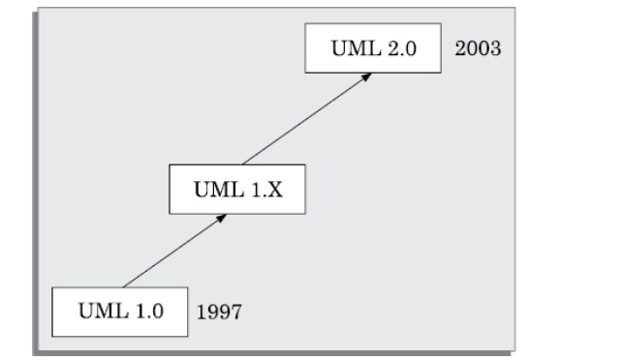
EVOLUTION OF UML

Slide 8
UNIFIED MODELLING LANGUAGE
UML is a language for documenting models.
UML has its syntax (a set of basic symbols and sentence formation rules) and semantics (meanings of basic symbols and sentences).
It provides a set of basic graphical notations (e.g. rectangles, lines, ellipses, etc.) that can be combined incertain ways to document the design and analysis results

Slide 9
What is a model?
A model is an abstraction of a real problem (or situation), and is constructed by leaving out unnecessary details.
Why construct a model?
It helps to manage the complexity in a problem and facilitates arriving at good solutions and at the same time helps to reduce the design costs.
Analysis and Design models can be used for a variety of purposes during software development:
Analysis
Specification
Design
Coding
Visualisation and understanding of an implementation.
Testing, etc.

Slide 10
UML DIAGRAMS
UML diagrams can capture the following views (models) of a system:
User’s view
Structural view
Behaviourial view
Implementation view
Environmental view

Slide 11
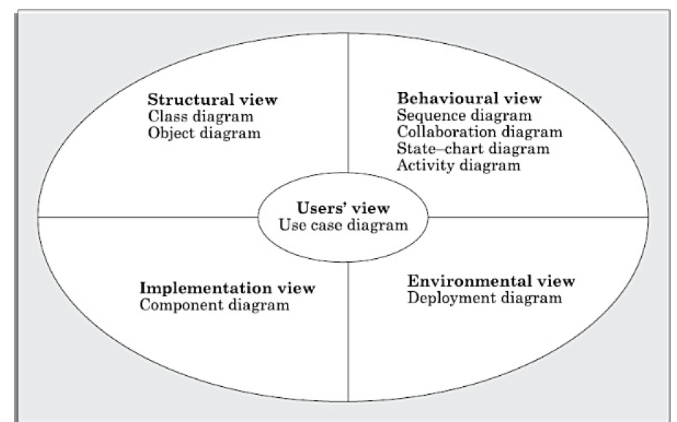
UML DIAGRAMS

Slide 12
USE CASE MODEL
The users’ view captures the view of the system in terms of the functionalities offered by the system to its users.
The use case model for any system consists of a set of use cases.
Intuitively, the use cases represent the different ways in which a system can be used by the users.
The use cases correspond to the high-level functional requirements.
The use cases partition the system behaviour into transactions, such that each transaction performs some useful action from the user’s point of view.

Slide 13
USE CASE MODEL
A simple way to find all the use cases of a system is to ask the question
—“What all can the different categories of users do by using the system?”
For the library information system (LIS), the use cases could be:
issue-book
query-book
return-book
create-member
add-book, etc.

Slide 14
USE CASE MODEL
A use case typically involves a sequence of interactions between the user and the system.
A use case consists of one main line sequence and several alternate sequences.
The main line sequence represents the interactions between a user and the system that normally take place.
For example, in the mainline sequence of the withdraw cash use case supported by a bank ATM would be—the user inserts the ATM card, enters password, selects the amount withdraw option, enters the amount to be withdrawn, completes the transaction, and collects the amount.

Slide 15
USE CASE MODEL
Several variations to the main line sequence (called alternate sequences) may also exist.
For the bank ATM example, consider the following variations or alternate sequences:
Password is invalid.
The amount to be withdrawn exceeds the account balance.

Slide 16
Use case diagram :Representation of Use Cases
A use case model can be documented by drawing a use case diagram.
In the use case diagram, each use case is represented by an ellipse with the name of the use case written inside the ellipse.
All the ellipses (i.e. use cases) of a system are enclosed within a rectangle which represents the system boundary.
The name of the system being modeled (e.g., library information system ) appears inside the rectangle.
The different users of the system are represented by using stick person
icons.

Slide 17
Use case diagram :Representation of Use Cases
Each stick person icon is referred to as an actor.
An actor is a role played by a user with respect to the system use.
It is possible that the same user may play the role of multiple actors. An actor can participate in one or more use cases.
The line connecting an actor and the use case is called the Communication relationship.
It indicates that an actor makes use of the functionality provided by the use case.
Both human users and external systems can be represented by stick person icons. When a stick person icon represents an external system, it is annotated by the stereotype <<external system>>.

Slide 18
What is a Use case diagram
A use case diagram at its simplest is a representation of a user's interaction with the system that shows the relationship between the user and the different use cases in which the user is involved.
A use case diagram can identify the different types of users of a system and the different use cases and will often be accompanied by other types of diagrams as well.
The use cases are represented by either circles or ellipses.

Slide 19
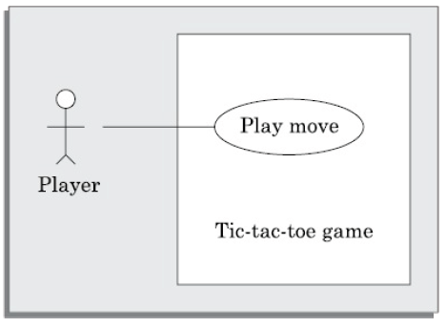
The use case model for the Tic-tac-toe game software
This software has only one use case, namely, “play move”.
Use cases should be named from the users’ perspective.

Slide 20
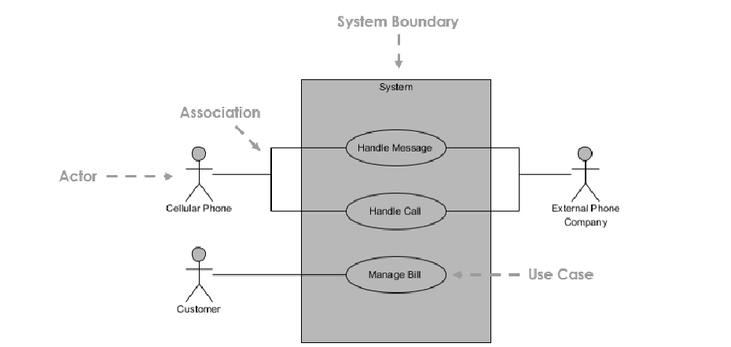
Use case diagram At a Glance
Each stick person icon is referred to as an actor.
An actor is a role played by a user with respect to the system use.
It is possible that the same user may play the role of multiple actors. An actor can participate in one or more use cases.
The line connecting an actor and the use case is called the Communication relationship.
It indicates that an actor makes use of the functionality provided by the use case.
Both human users and external systems can be represented by stick person icons. When a stick person icon represents an external system, it is annotated by the stereotype <<external system>>.

Slide 21
Purpose of Use case diagram
The use case model forms the core model to which all other models must conform.
Usecase diagrams helps to identify the different types of users (actors).
Used to gather the requirements of a system.
Used to get an outside view of a system.
Identify the external and internal factors influencing the system.
Show the interaction among the requirements and actors.
Specify the context of a system
Validate a systems architecture
Drive implementation and generate test cases

Slide 22
Use case diagram :Text description
The text description should define the details of the interaction between the user and the computer as well as other relevant aspects of the use case.
The following are some of the information which may be included in a use case text description in addition to the mainline sequence, and the alternate scenarios.
Actors: some information about actors using a use case may be recorded
Pre-condition: The preconditions would describe the state of the system
before the use case execution starts.
Post-condition: This captures the state of the system after the use case has
successfully completed.
Exceptions, error situations

Slide 23
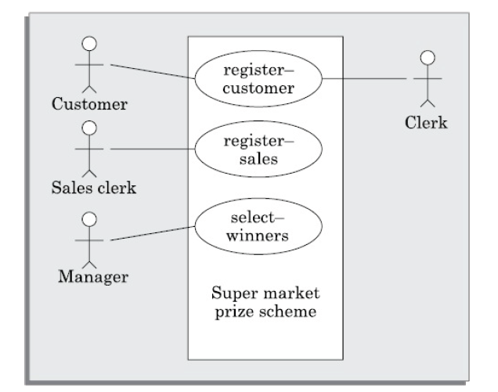
Use case diagram :Example

Slide 24
Use case diagram :Text description
Text description
U1: register-customer: Using this use case, the customer can register
himself by providing the necessary details.
Scenario 1: Mainline sequence
1. Customer: select register customer option
2 . System: display prompt to enter name, address, and telephone number.
3. Customer: enter the necessary values
4: System: display the generated id and the message that the customer has successfully been registered.

Slide 25
Use case diagram :Text description
Scenario 2: At step 4 of mainline sequence
4 : System: displays the message that the customer has already registered.
Scenario 3: At step 4 of mainline sequence
4 : System: displays message that some input information have not been entered. The system displays a prompt to enter the missing values.

Slide 26
Structuring Relationship in a Usecase diagram
1.ASSOCIATION BETWEEN ACTOR AND USECASE
2.GENERALIZATION OF USE CASE
3.INCLUDE BETWEEN TWO CASES
4.EXTEND BETWEEN TWO USE CASES
5.GENERALIZATION OF AN ACTOR

Slide 27
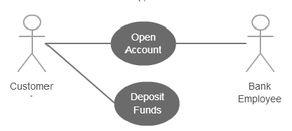
1.ASSOCIATION BETWEEN ACTOR AND USECASE
An actor must be associated with atleast one usecase.
An actor can be associated with multiple usecases.
Multiple actors can be associated with a single usecase.

Slide 28
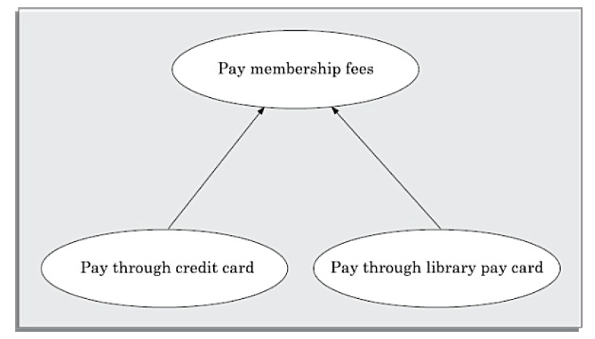
2.GENERALIZATION OF USE CASE
Use case generalisation can be used when you have one use case that is similar to another, but does something slightly differently or something more.
The child use case inherits the behaviour and meaning of the present use case.

Slide 29
3.INCLUDE BETWEEN TWO CASES
The includes relationship implies one use case includes the behaviour of another use case in its sequence.
The includes relationship is appropriate when you have a chunk of behaviour that is similar across a number of use cases.
Thus, the includes relationship explores the issue of reuse by factoring out the
commonality across use cases.
The includes relationship is represented using a predefined stereotype <<include>>.
In the includes relationship, a base use case compulsorily and automatically includes the behaviour of the common use case.

Slide 30
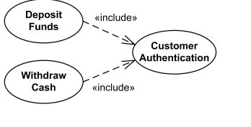
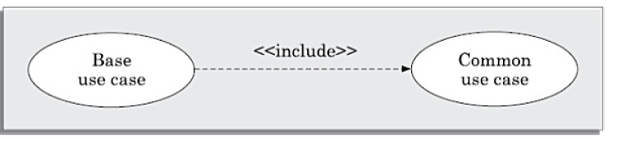
Includes in Use case diagram
.

Slide 31
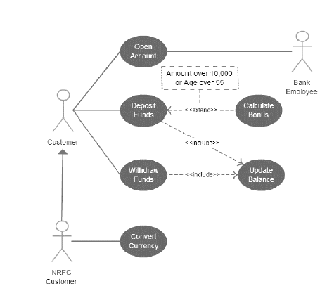
3.INCLUDE BETWEEN TWO CASES

Slide 32
4. EXTEND BETWEEN TWO CASES
The main idea behind the extends relationship among use cases is that it
allows you show optional system behaviour.
An optional system behaviour is executed only if certain conditions hold, otherwise the optional behaviour is not executed.
The extends relationship is similar to generalisation. But unlike generalisation, the extending use case can add additional behaviour only at an extension point only when certain conditions are satisfied.
The extension points are points within the use case where variation to the mainline
(normal) action sequence may occur.
The extends relationship is normally used to capture alternate paths or scenarios.

Slide 33
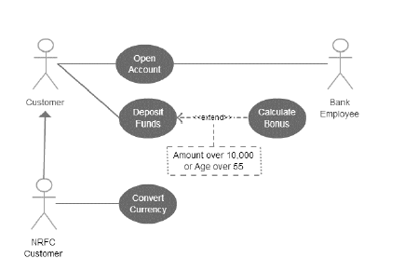
4. EXTEND BETWEEN TWO CASES

Slide 34
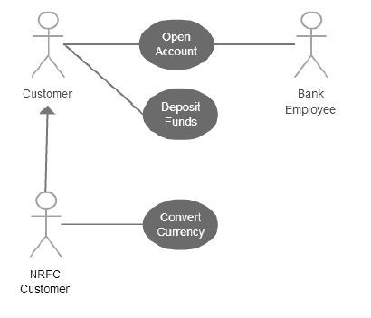
5.GENERALIZATION OF AN ACTOR
Generalization of an actor means an actor can inherit the role of the other actor.
Descendent inherits all the usecases of the ancestor
The descendent has one or more usecases that are specific to that role.

Slide 35
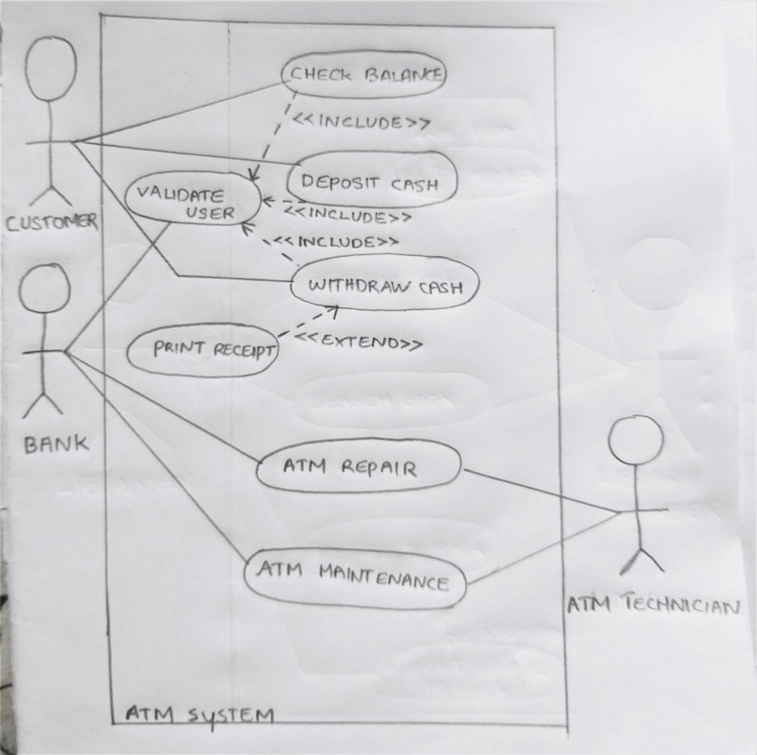
Use case diagram of a ATM system showing extend and include features:

Slide 36
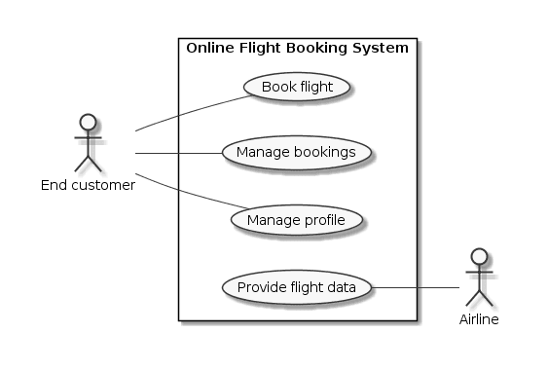
EXAMPLES OF USECASE DIAGRAM

Slide 37
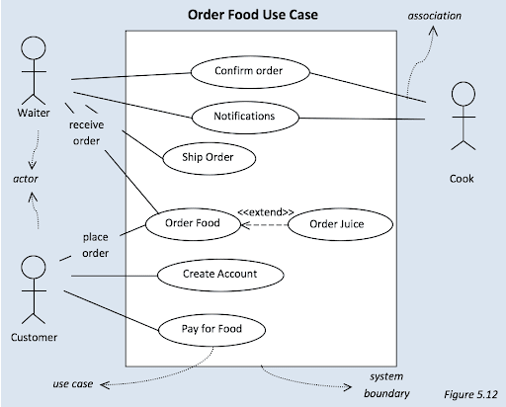
EXAMPLES OF USECASE DIAGRAM

Slide 38
SUMMARY
Object modelling is very important in analysing, designing, and understanding systems.
UML has rapidly gained popularity and is poised to become a standard in object modelling.
UML can be used to construct five different views of a system using nine different kinds of diagrams.
We discussed the syntax and semantics of some important types of use case diagrams which can be constructed using UML.

Slide 39
Thanks!
Any questions?

